Slide 1
Popular

Slide 2
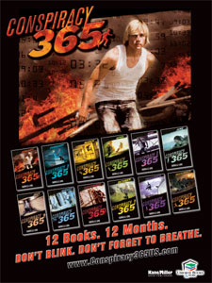
Book 1 of 13
Suspense-Thriller
Cliffhanger
Realistic Fiction
Should read books in order
15-yr-old Callum Ormond

Slide 3
Dystopian
16-yr-old Beatrice
Choosing Day
Factions: Abnegation, Candor, Erudite, Dauntless
Internal Struggles
Book 2: Insurgent

Slide 4
Made into a movie
Book 1 of 3
Dystopian
Nation of Panem – capitol w/ 12 outlying districts
1 boy + 1 girl from ea. District – Hunger Games
Katniss Everdeen, Prim, Gale, Peeta

Slide 5
Dystopian
The Glade
New Boy every 30 days
Thomas
Grievers
Suspense-Thriller
Book 1 of 4
If you liked “City of Ember”

Slide 6
Frequently Challenged

Slide 7
Dystopian
Award-Winning
Often challenged
Jonas, Fiona
12-yrs old receive life assignment
Book 1 of 4

Slide 8
Realistic Fiction
Frequently challenged/banned
Strong adult lang.
Teen Issues
Dysfunctional fam.
Punk/Rock Band
Troy – unhappy, insecure
Curt MacCrae – homeless, dropout

Slide 9
Award Winning

Slide 10
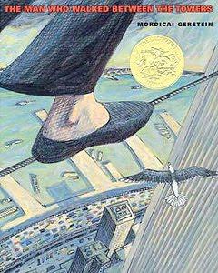
True story
Picture Book
Twin Towers – NYC
Philippe Petit

Slide 11
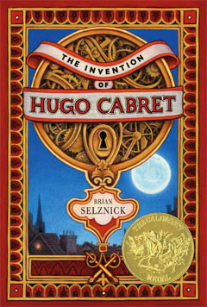
Made into a movie
12-yr-old Hugo
Orphan, thief, clock keeper
Paris train station
Mystery
Cryptic dwg, key, notebook
Picture/graphic novelish

Slide 12
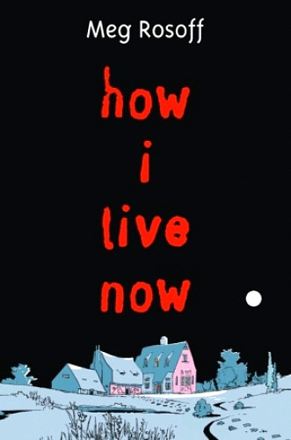
British War
Young Love
Survival
Some violence
Strong female characters
No adults/no rules
Daisy & Piper

Slide 13
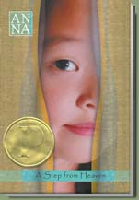
Korean culture
“fitting” in in America
Abusive parent
Young Ju (brother Joon)

Slide 14
Realistic Fiction
Survival
Abandonment
Death
Teen issues
Some guns and sex
Parallel stories around same school

Slide 15
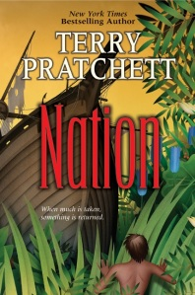
Survival
Adventure
Friendship
Historical
Gods / Science
Mau, Daphne

Slide 16
Told from Death’s perspective
Nazi Germany
Some parts based on true events
Historical Fiction
Liesel Meminger

Slide 17
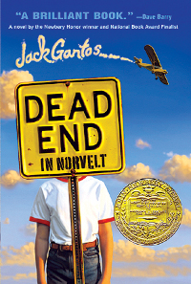
Author of Joey Pigza books
Sort of a memoir or autobiography
Funny
Growing up in slightly off-kilter place
Jack Gantos
Mrs. Volker

Slide 18
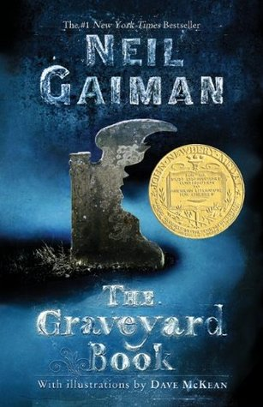
The Man Jack
Nobody Owens “Bod”
Silas
Ghosts & Graveyard
Book Trailer

Slide 19
Other Awards

Slide 20
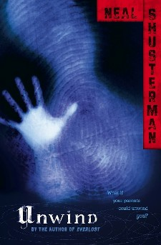
Futuristic
Moral issues
Connor, Risa, Lev
Unwound, ages 13-18
Suspense
Unwholly

Slide 21
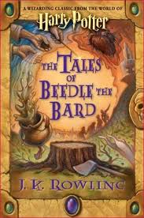
Wizard fairy tales
Mentioned in 7th HP book
Short, fun
Moral

Slide 22
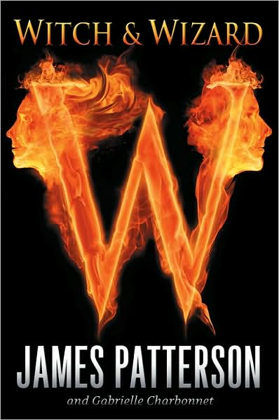
Fantasy, magic
May appeal to HP fans
Whit, Wisty (15)
Discover powers in prison
Dystopian twist
Book 1 of 4

Slide 23
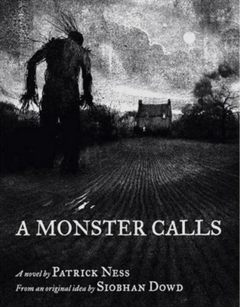
Realistic
Parent relationships
Death
Monsters – real, imaginary
Mischief
Loss
Conor (13)

Slide 24
Nonfiction
P.T. Barnum
Circus
“Pranks” on public
Strange/bizarre
inhumane

Slide 25
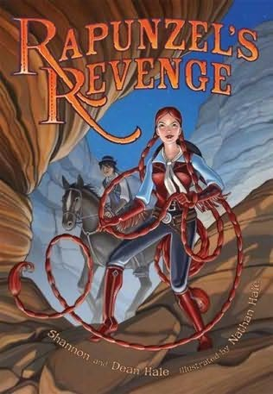
Graphic Novel
Fairy Tale
Adventure
Strong female character
Jack (beanstalk)

Slide 26
Read!!

